Slide 1

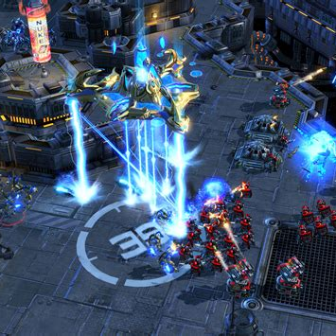
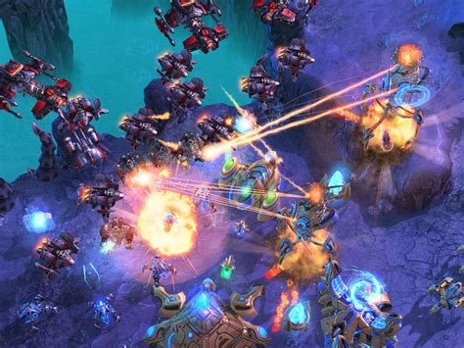
SKILLCRAFT DATASET ANALYSIS
By Valentin DUPUIS

Slide 2

Introduction
This dataset gathers data on the starcraft 2 video game. It is a real-time strategy game. Players can play against players or against the AI. Entries are various data that could be retrieved or calculated from a game. One line corresponds to a summary of a player's game. The output corresponds to the level of the player concerned. There are 8 different player level. The objective of this analysis is to understand and be able to predict the level of a player based on the most interesting entries.

Slide 3
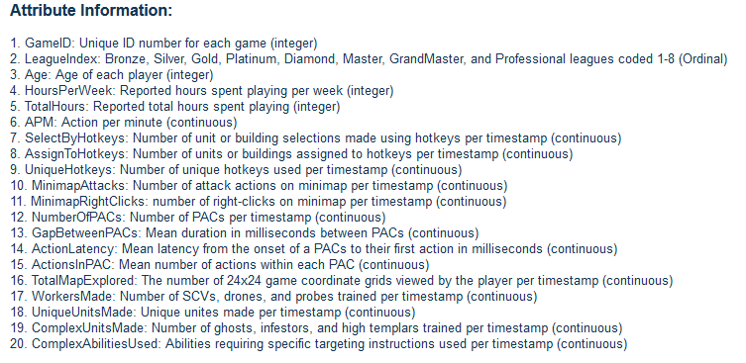
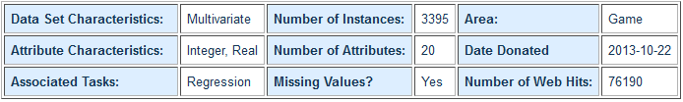
DataSet Presentation

Slide 4
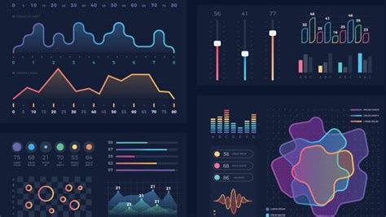
Thoughts on the problem and Data Exploration

Slide 5
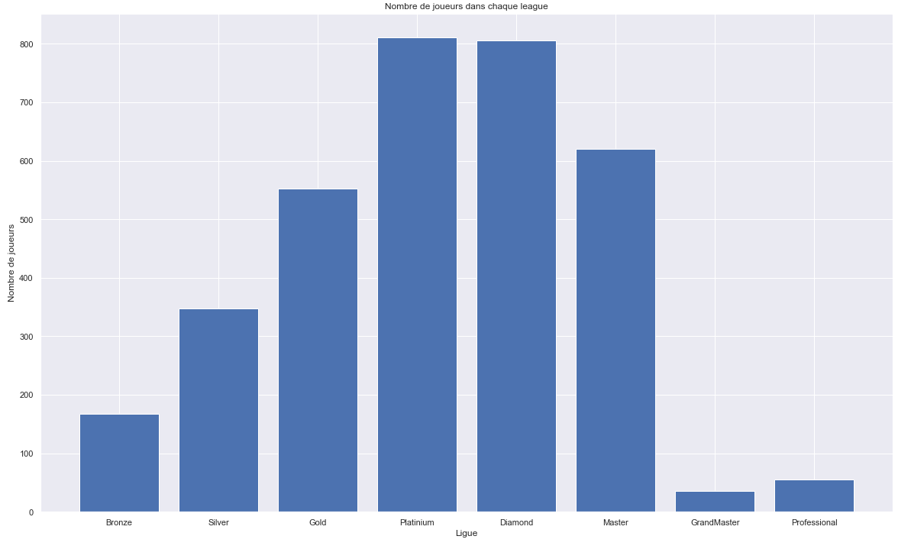
To start, we had to explore the dataset. For that I used the panda module.
I was able to do several visualizations to understand the dataset. For example, we can see the number of players per level here. I also used a maping to better understand the level of the players which goes from Bronze to GrandMaster / Professional, it is a level scale that we find in many video games nowadays.
Here we see that the distribution of player in the dataset seems to be of normal law in the dataset. Which may correspond to the real distribution of all players.

Slide 6
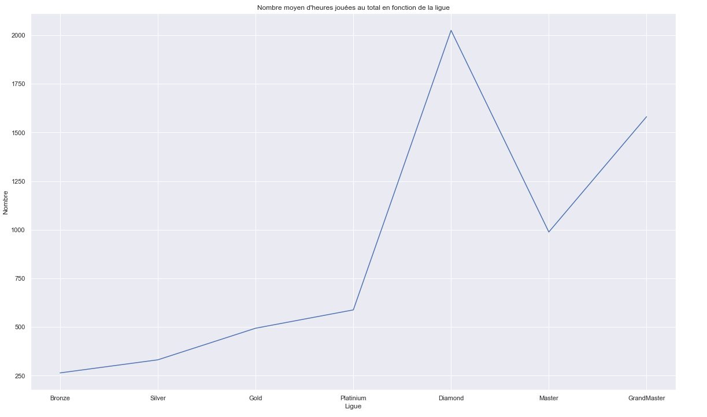
Here we can see the average number of hours played in total depending on the league. We can notice that up to the diamond level there is a linear relationship between playing time and level. But this is stopped by the Grand Master level. There would be a form of "talent" without a lot of playing time for these players. Knowing that the number of diamond and master players is appreciably close (800 and 650).

Slide 7
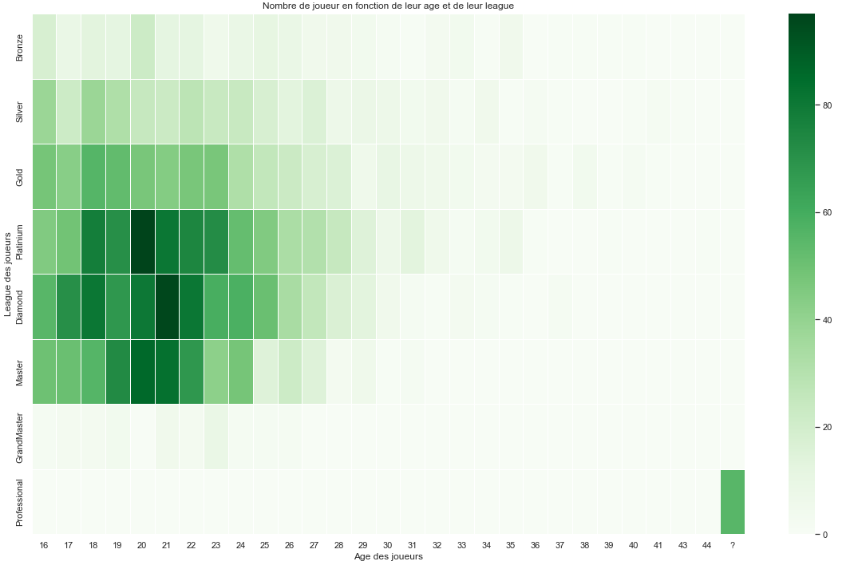
Here I made a Heatmap of the age of players and their league.
We see that the game mainly interests young people and that many are between platinum and diamond as confirmed by the previous histogram.
We can also notice something very interesting: for the "professional" release we do not know the age of the players.
It was from this graph that I noticed that some features were missing data for these players, which is why I decided not to take them into account in the modeling part.

Slide 8
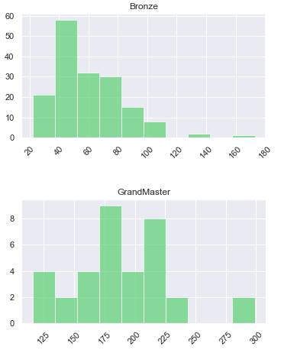
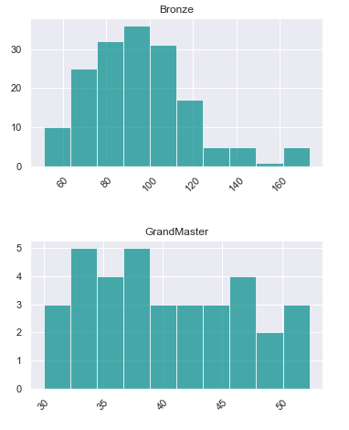
I made several other visuals like histograms between bronze players and grandmaster players. By comparing these two types of players the differences are glaring.
In green we have the APM, Action Per Minute, and we can clearly see that the grandmasters are much more efficient in this area than the bronze ones.
In blue these are the Action Latency, which can be matched to the players' "thinking / action time". We can see that the GrandMasters are much faster.

Slide 9
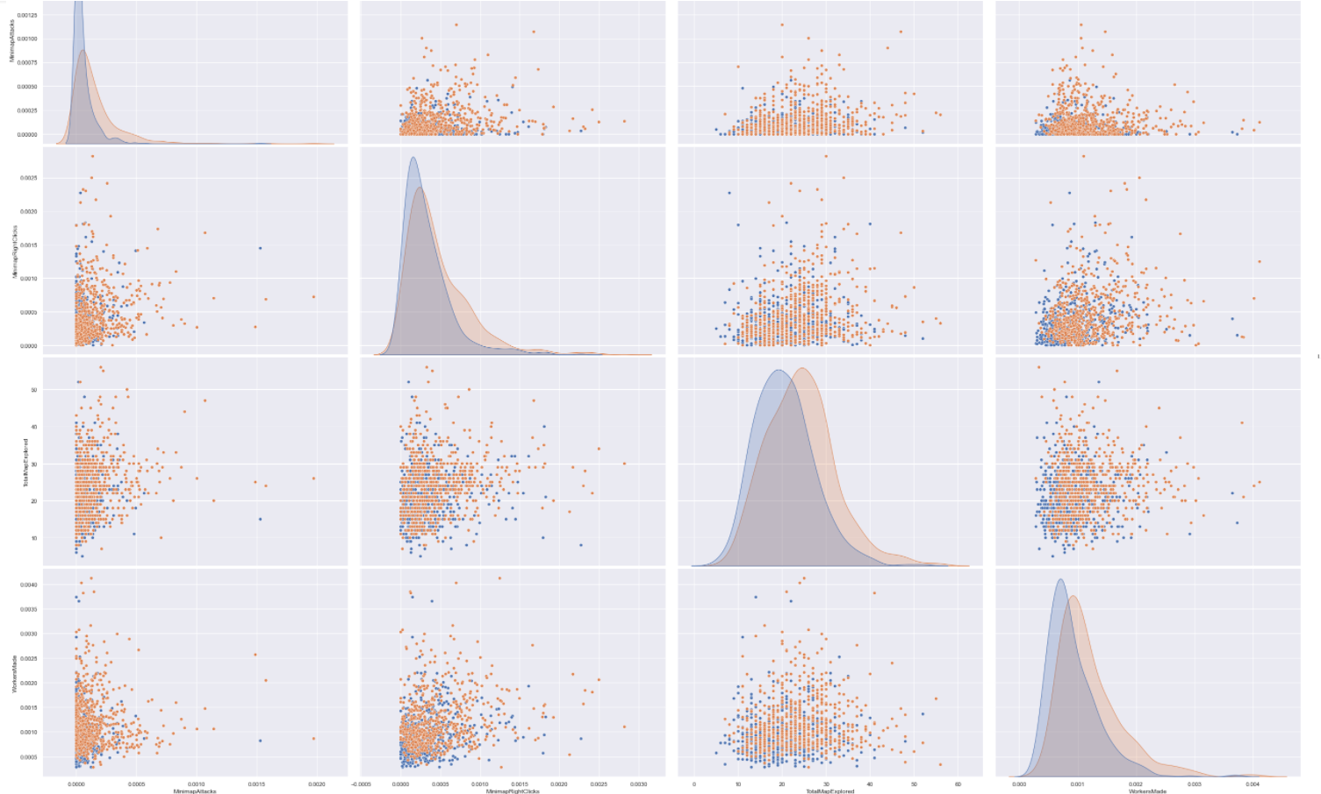
Here we have the comparison between the gold (blue) and the master (orange) which are almost as numerous. We can see that in the four features chosen the masters are always "better". The differences may seem slight but "all" the features together justify a better level of master players.
The visuals and graphics are available in the attached python notebook for better reading.

Slide 10
Modeling

Slide 11
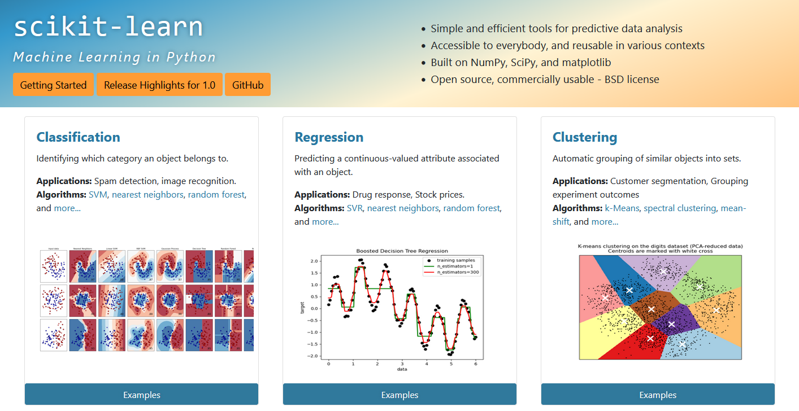
For the modeling part I used sklearn.
I arbitrarily chose certain variables of the dataset to use. Then I divided my dataset (without the professionals) into training and testing set.
I standardize the values using the minMaxScaler from sklearn.preprocessing. Finally I chose several models to test.

Slide 12



The scores obtained were not very interesting as shown here. This is probably due to a bad preprocessing on my part. I could have done a PCA to know the best features to use. I should have tested other sklearn transformers and done more testing.

Slide 13
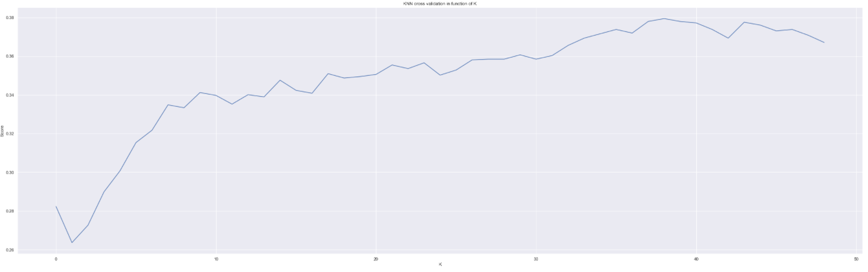
Despite everything, I decided to test a cross validation on a KNN in addition to changing the K (from 1 to 50) and here is the result. This result is still not satisfactory but shows the concept of cross validation and change of hyperparameter of an algorithm.

